Slide 1
Recurrent neural networks (RNN)

Slide 2
What is a recurrent neural network (RNN)?
RNN models sequential data (temporal/ordinal)
In RNN, training example is a sequence, which is presented to RNN one at a time
E.g., sequence of English words is passed to RNN, one at a time
And, RNN generates a sequence of Persian words, one at a time
In RNN, output of network at time t is used as input at time t+1
RNN applied to image description, machine translation, sentiment analysis, etc.

Slide 3
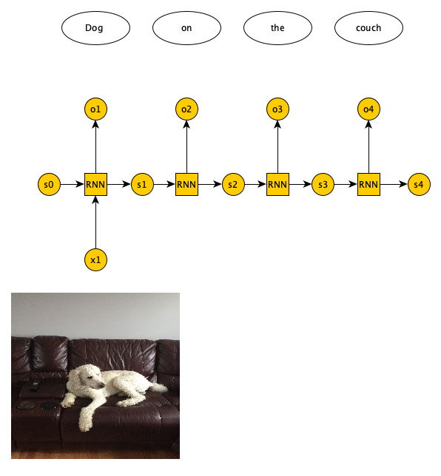
One-to-many RNN

Slide 4
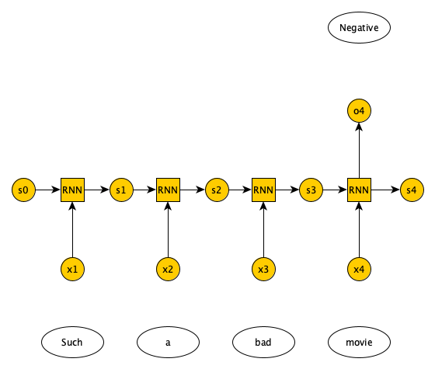
Many-to-one RNN

Slide 5
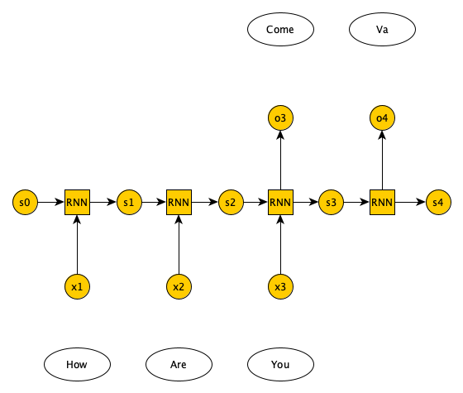
Many-to-many RNN

Slide 6
RNN architectures
Vanilla RNN
Suffers from vanishing gradient problem
LSTM and GRU
Uses gates to avoid vanishing gradient problem

Slide 7
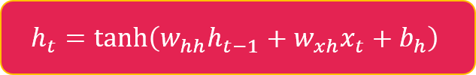
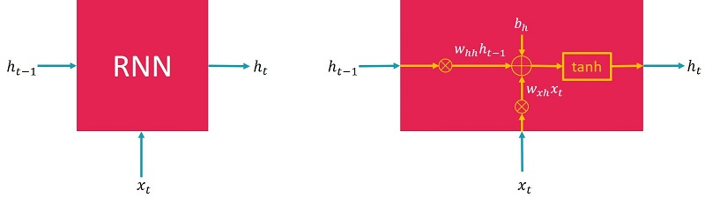
RNN architectures

Slide 8
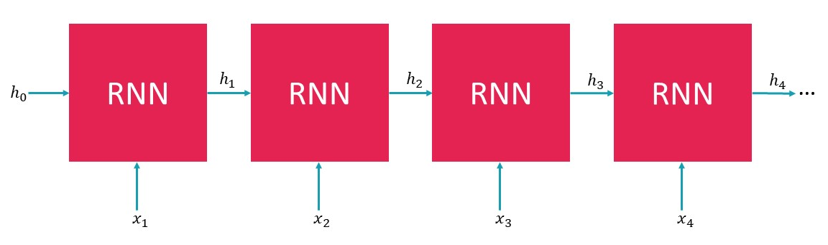
RNN architectures

Slide 9
Sentiment analysis
We perform sentiment analysis on IMDB movie reviews dataset
Train RNN on training dataset (25000 positive/negative movie reviews)
Test RNN on test set (25000 positive/negative movie reviews)
Training and test sets have no overlap
Since dealing with text data, good to review mechanisms for representing text data

Slide 10
Text preprocessing
Tokenize a document, i.e., break it down into words
Remove punctuations, URLs, and stop words (‘a’, ‘of’, ‘the’, etc.)
Normalize the text, e.g., replace ‘brb’ with ‘Be right back’, etc
Run the spell checker to fix typos
Make all words lowercase

Slide 11
Text preprocessing
Perform stemming/lemmatization
If we have words like ‘organizer’, ‘organize’, and ‘organized’
Want to reduce all of them to a single word
Stemming cuts end of these words for a single root
E.g., ‘organiz’. May not be an actual word
Lemmatization reduces to a root that is actually a word
E.g., ‘organize’

Slide 12
Bag of words (BoW)
If you don’t care about the order of the words in a document
2D array. Rows represent documents. Columns represent words in vocabulary
All unique words in all documents
If a word not present in a document, we have a zero at row and column entry
If a word is present in a document, we have a one at row and column entry
Or, we could use the word count or frequency

Slide 13
Bag of words (BoW)
Document 1: Magic passed the basketball to Kareem
Document 2: Lebron stole the basketball from Curry
BoW is simple, but does not consider rarity of words across documents
Important for document classification

Slide 14
Term frequency inverse document frequency (TF-IDF)
If you don’t care about the order of the words in a document
Similar to BoW, we have an entry for each document-word pair
Entry is product of
Term frequency, frequency of a word in a document, and
Inverse document frequency, total number of documents divided by number of documents that have word
Usually use logarithm of the IDF
TF-IDF takes into account rarity of a word across documents

Slide 15

One-hot encoding (OHE)
Technique to convert categorical variables such as words into a vector
Suppose our vocabulary has 3 words: orange, apple, banana
Each word is represented by a vector of size 3
OHE problems
For very large vocabulary sizes requires tremendous amount of storage
Also, no concept of word similarity

Slide 16
Word2Vec
Each word represented as an n dimensional vector
n much smaller than vocabulary size
Words that have similar meanings are close in vector space
Words considered similar if they co-occur often in documents
Two Word2Vec architectures
Continuous BoW
predicts probability of a word given the surrounding words
Continuous skip-gram
given a word predicts probability of the surrounding words

Slide 17
Sentiment analysis
Sentiment classification of IMDB movie reviews with RNN
Train RNN using IMDB movie reviews
Goal is to learn a model such that given a review we predict whether review is positive/negative
We evaluate the trained RNN on test dataset and plot confusion matrix

